Slide 1
DIGESTION & ABSORPTION OF CARBOHYDRATES
Dr Amena Rahim
MBBS, FCPS, PhD, PGDE, JMHPE
Professor & HOD of Biochemistry

Slide 2
Introduction
Carbohydrates are the largest source of calories – 40-45%
Plant starches – amylose and amylopectin – 50- 60%
Foods derived from animals- glycogen and glycolipids

Slide 3
Dietary fiber - Plant polysaccharides – composed of polymer lignin
Carbohydrates essential for all the cells but not essential to take it in the diet
Can be synthesized from amino acids
All sugars can be synthesized from glucose

Slide 4
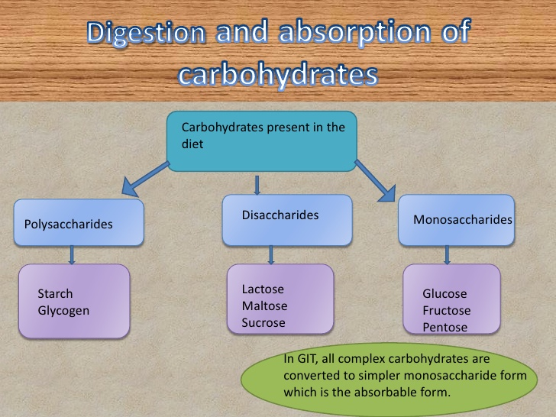

Slide 5
Starch glycogen sucrose lactose and cellulose are the chief carbohydrates in our food
Before intestinal absorption, they are hydrolyzed to hexose sugars (glucose galactose and fructose)

Slide 6
A family of a glycosidases that degrade carbohydrate into their monohexose components catalyzes hydrolysis of glycocidic bonds
These enzymes are usually specific to the type of bond to be broken

Slide 7
.
The principal sites of dietary carbohydrate digestion are the mouth and intestinal lumen
This digestion is rapid and is generally completed by the time the stomach contents reach the junction of the duodenum and jejunum

Slide 8
There is little monosaccharide present in diets of mixed animal and plant origin
The enzymes needed for degradation of most dietary carbohydrates are primarily endoglycosidases that hydrolyze oligosaccharides and polysaccharides and disaccharidases

Slide 9
These enzymes are usually specific for the structure and configuration of the glycosyl residue to be removed as well as for the type of bond to be broken

Slide 10
Glycosidic bonds
These are Covalent chemical bonds that hold together a glycoside
A glycoside is simply a ring-shaped sugar molecule that is attached to another molecule
The sugar ring may be either a 5-membered ring or a 6-membered ring and the other molecule can be - and often is - another sugar

Slide 11
Glycosidic bonds join monosaccharides to other carbohydrates forming:
Disaccharides Oligosaccharides and
Polysaccharides

Slide 12
Important disaccharides include lactose (galactose + glucose) sucrose (glucose + fructose) and maltose (glucose + glucose)
Important polysaccharides include branched glycogen (from animal sources) and starch (plant sources) and unbranched cellulose (plant sources)

Slide 13
Glycosidic bonds between sugars are named according to the numbers of the connected carbons and with regard to the position of the anomeric hydroxyl group of the sugar involved in the bond
If this anomeric hydroxyl is in the α configuration the linkage is an α-bond If it is in the β configuration the linkage is a β-bond

Slide 14
Carbohydrates can be attached by glycosidic bonds to noncarbohydrate structures including
Purine and pyrimidine bases (found in nucleic acids)
Aromatic rings (such as those found in steroids and bilirubin)
Proteins (found in glycoproteins and proteoglycans)
Lipids (found in glycolipids) to form glycosides

Slide 15
Glycosidic bonds can either be O-linked or N-linked

Slide 16
If the group on the noncarbohydrate molecule to which the sugar is attached is an –NH₂ group the structure is an N-glycoside and the bond is called an N-glycosidic link
If the group is an –OH the structure is an O-glycoside and the bond is an O-glycosidic link

Slide 17
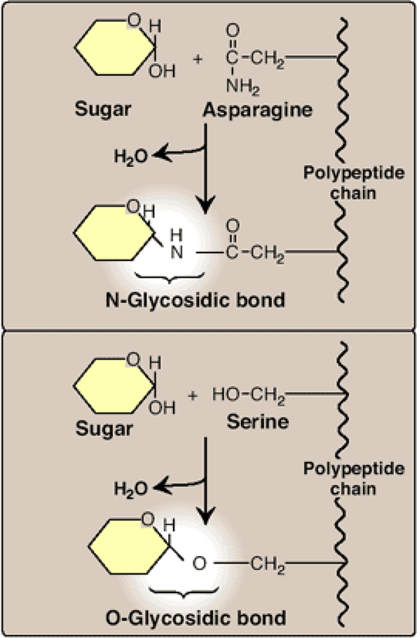

Slide 18
Digestion of carbohydrate by salivary α -amylase (ptyalin) in the mouth
This enzyme is produced by salivary glands
Its optimum pH is 6.7
It is activated by chloride ions
It acts on cooked starch and glycogen breaking α 1-4 bonds converting them into maltose [a disaccharide containing two glucose molecules attached by α 1-4 linkage]

Slide 19
The major dietary polysaccharides are of plant (starch- composed of amylose and amylopectin) and animal (glycogen) origin
During mastication salivary α-amylase acts briefly on dietary starch and glycogen hydrolyzing random α(1→4) bonds

Slide 20
Because branched amylopectin and glycogen also contain α(1→6) bonds which α-amylase cannot hydrolyze the digest resulting from its action contains a mixture of short branched and unbranched oligosaccharides known as DEXTRINS
Disaccharides are also present as they too are resistant to amylase

Slide 21
Food remains for a short time in the mouth digestion of starch and glycogen may be incomplete and gives a partial digestion products called:
STARCH DEXTRINS
(amylodextrin erythrodextrin and achrodextrin)

Slide 22
Therefore digestion of starch and glycogen in the mouth gives maltose isomaltose and starch dextrins

Slide 23
There are both α(1→4)- and β(1→4)-endoglucosidases in nature but humans do not produce β(1→4)
Therefore we are unable to digest cellulose a carbohydrate of plant origin containing β(1→4) glycosidic bonds between glucose residues

Slide 24
IN THE STOMACH
Carbohydrate digestion stops temporarily due to the high acidity which inactivates the salivary - amylase

Slide 25
Digestion of carbohydrate by the pancreatic – amylase in the small intestine
α-amylase enzyme is produced by pancreas and acts in small intestine
Its optimum pH is 7.1
It is also activated by chloride ions
It acts on cooked and uncooked starch hydrolyzing them into maltose isomaltose and oligosaccharides

Slide 26
When the acidic stomach contents reach the small intestine they are neutralized by bicarbonate secreted by the pancreas and pancreatic α-amylase continues the process of starch digestion

Slide 27
Final carbohydrate digestion by intestinal enzymes
The final digestive processes occur at the small intestine and include the action of several Disaccharidases
These enzymes are secreted through and remain associated with the brush border of the intestinal mucosal cells

Slide 28
The density and distribution of brush border enzymes differs among different segments of the small intestine and often varies depending on the age

Slide 29
These brush border glycosidases activity are found in four glycoproteins:
Maltase/Glucoamylase – amylose amylopectin glycogen and maltose
Sucrase/isomaltase- maltose sucrose and maltotriose
Have activity for α-1-6 bonds and α-1-4 bonds at nonreducing ends

Slide 30
3. β glycosidase- ceramidases & Lactase
4. Trehalase- 2 glucose units linkage is α1-1

Slide 31
The disaccharidases include:
Lactase (β-galactosidase) which hydrolyses β(1→4) lactose into two molecules of glucose and galactose:
Lactase
Lactose Glucose + Galactose

Slide 32
Maltase ( α-glucosidase), which cleaves α(1→4) bond in maltose & maltotriose into two molecules of glucose:
Maltase
Maltose Glucose + Glucose

Slide 33
Sucrase – which cleaves α(1→2)bond in sucrose into two molecules of glucose and fructose:
Sucrase
Sucrose Glucose + Fructose

Slide 34
α - dextrinase (or isomaltase) which hydrolyze α(1→6) linkage of isomaltose
Dextrinase
Isomaltose Glucose + Glucose

Slide 35
Location within the intestine
Pancreatic α-amylase duodenum
Sucrase/isomaltase jejunum
β glycosidase jejunum
Glucoamylase – activity increases along the length of small intestine and is highest in the ileum
Final opportunity for starch digestion

Slide 36
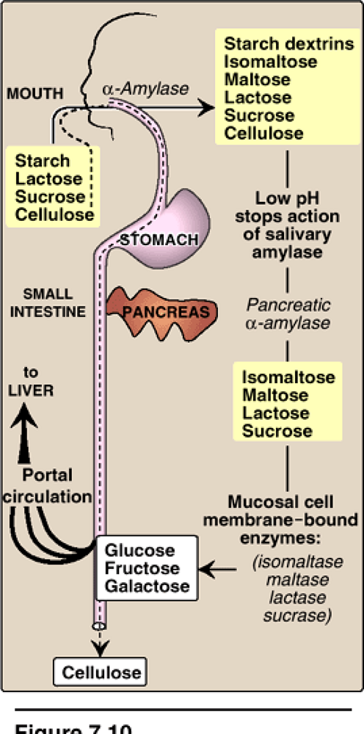

Slide 37
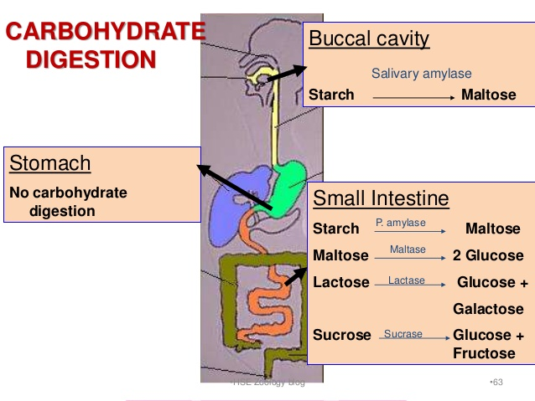

Slide 38
Digestion of cellulose
Cellulose contains β(1-4) bonds between glucose molecules
In humans, there is no β (1-4) glucosidase that can digest such bonds. So cellulose passes as such in stool
Cellulose helps water retention during the passage of food along the intestine → producing larger and softer feces → preventing constipation

Slide 39
Types of fibers in the diet
Cellulose
Hemicellulose
Lignin
Pectin
Gums
Mucilages

Slide 40
Metabolism by colonic bacteria
Colonic bacteria metabolize the Saccharides to: gases short chain fatty acids and lactate
Major short chain fatty acids are: acetic acid propionic acid and butyric acid
Major gases are: hydrogen methane and CO₂

Slide 41
Absorptions
The end products of carbohydrate digestion are monosaccharides: glucose galactose and fructose
They are absorbed from the jejunum to portal veins to the liver where fructose and galactose are transformed into glucose

Slide 42
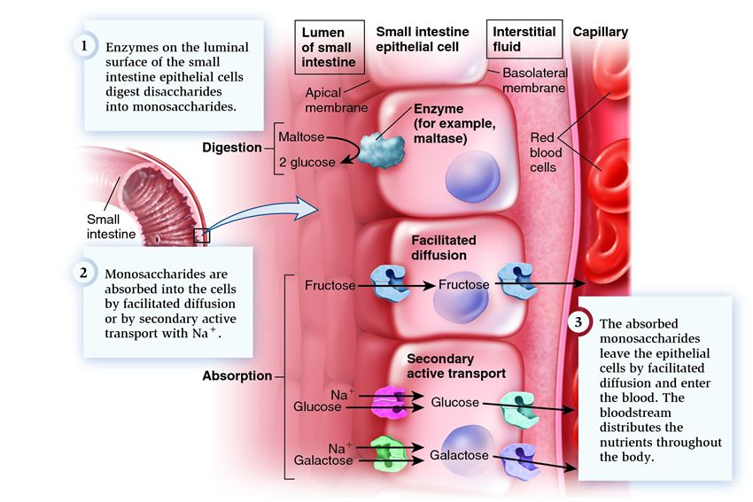

Slide 43
Transport of Glucose Into Cell
Glucose cannot diffuse directly into cells but enters by one of two transport mechanisms
Na+ independent facilitated diffusion transport system
and Na+ monosaccharide co-transport system

Slide 44
Two mechanisms are responsible for absorption of monosaccharides:
Active Transport (against concentration gradient i.e., from low to high concentration)
Passive Transport (by facilitated diffusion)

Slide 45
Mechanisms of absorption
Active Transport:
In the cell membrane of the intestinal cells there is a mobile carrier protein called sodium dependent glucose transporter (SGLT-1)

Slide 46
It transports glucose to inside the cell using energy. The energy is derived from sodium-potassium pump
The transporter has 2 separate sites one for sodium and the other for glucose

Slide 47
It transports them from the intestinal lumen across cell membrane to the cytoplasm
Then both glucose and sodium are released into the cytoplasm allowing the carrier to return for more transport of glucose and sodium

Slide 48
The sodium is transported from high to low concentration (with concentration gradient) and at the same time causes the carrier to transport glucose against its concentration gradient
The Na+ is expelled outside the cell by sodium pump which needs ATP as a source of energy

Slide 49
The reaction is catalyzed by an enzyme called “Adenosine triphosphatase (ATPase)”
Active transport is much more faster than passive transport

Slide 50
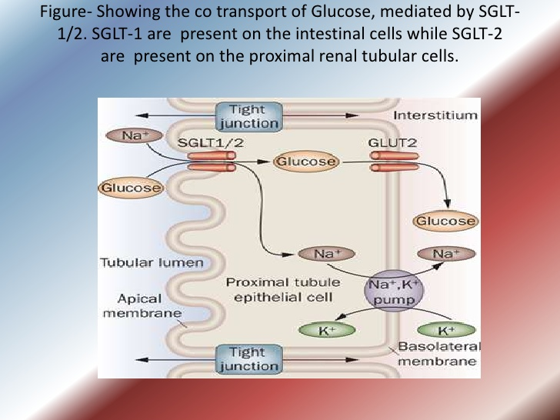

Slide 51
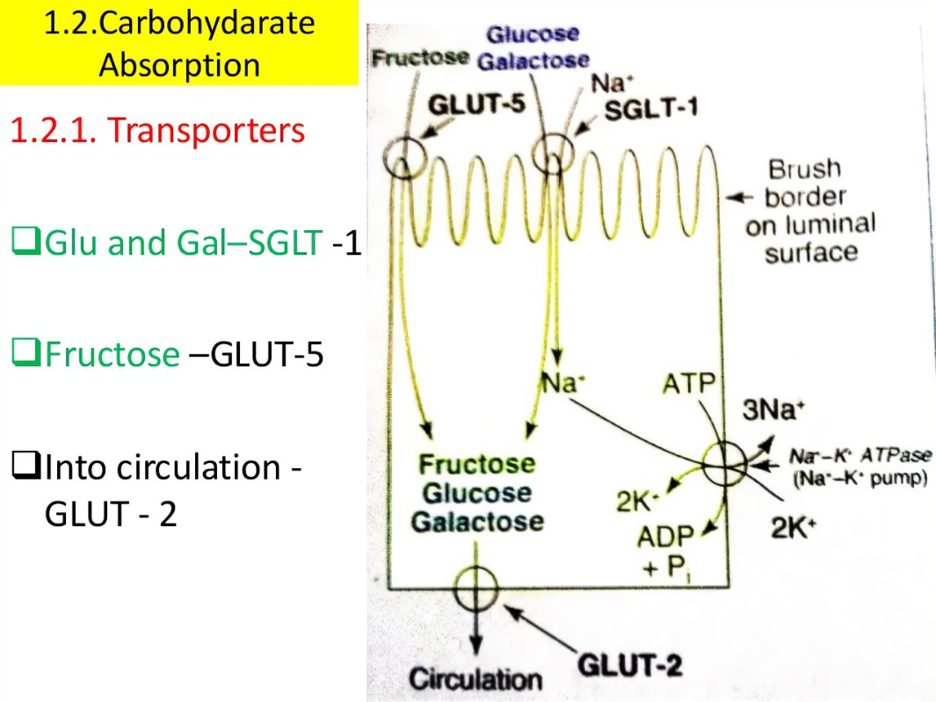

Slide 52
Na+ -independent facilitated diffusion
This system is mediated by a family of at least fourteen glucose transporters in cell membranes.
They are designated GLUT-1 to GLUT-14 (glucose transporter isoforms)

Slide 53
Specialized functions of GLUT isoforms
In facilitated diffusion glucose movement follows a concentration gradient that is from a high glucose concentration to a lower one

Slide 54
These transporters exist in the membrane in two conformational states
Extracellular glucose binds to the transporter, which then alters its conformation, transporting glucose across the cell membrane

Slide 55
Insulin increases the number of glucose transporters in tissues containing insulin receptors e.g., muscles and adipose tissue
Occurs in the epithelial cells of intestine renal tubules and choroid plexus

Slide 56
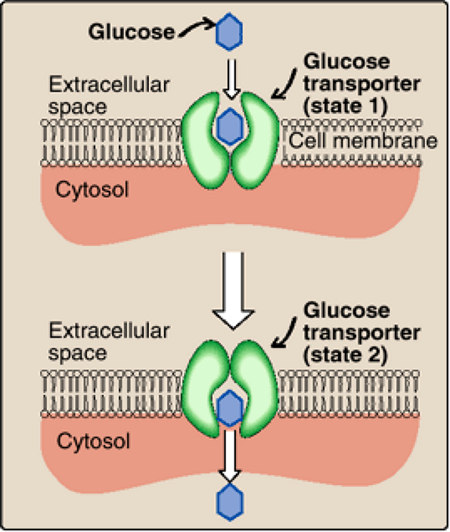

Slide 57
For example GLUT-1 GLUT-3 and GLUT-4 are primarily involved in glucose uptake from the blood

Slide 58
Tissue specificity of GLUT gene expression
glucose transporters display a tissue-specific pattern of expression.
GLUT-1 is abundant in erythrocytes and brain but is low in adult muscle
GLUT-3 is the primary glucose transporter in neurons
GLUT-4 is abundant in adipose tissue and skeletal muscle

Slide 59
In contrast GLUT-2 which is found in the liver and kidney can either transport glucose into these cells when blood glucose levels are high or transport glucose from the cells to the blood when blood glucose levels are low
(GLUT-2 is also found in the pancreas)

Slide 60
GLUT-5 is unusual in that it is the primary transporter for fructose (instead of glucose) in the small intestine and the testes
GLUT-7 which is expressed in the liver and other gluconeogenic tissues mediates glucose flux across the endoplasmic reticular membrane

Slide 61
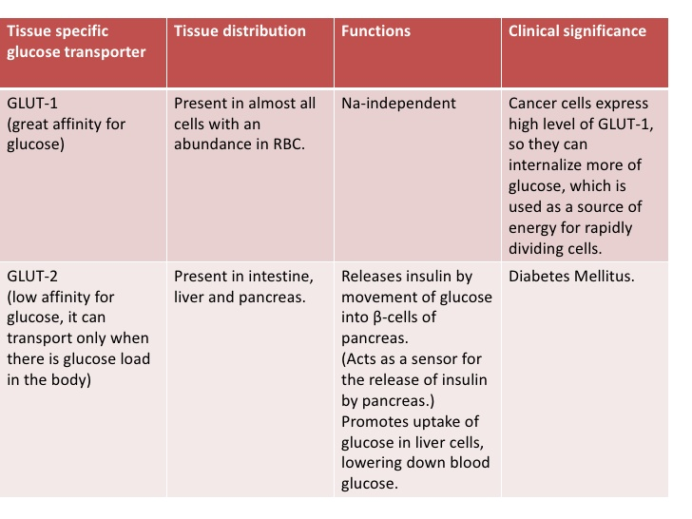

Slide 62
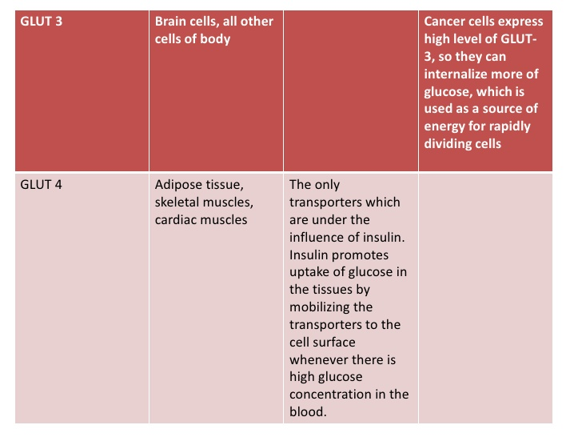

Slide 63
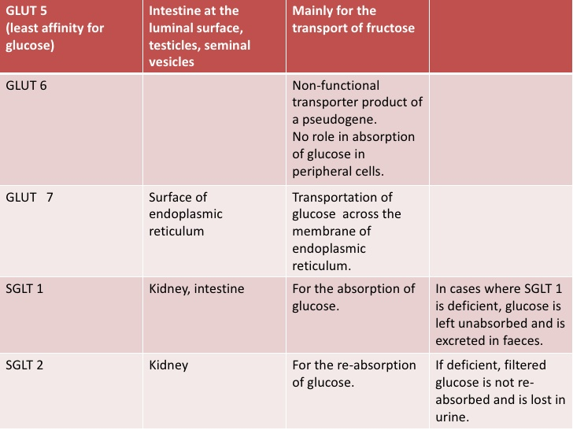

Slide 64
Defects of carbohydrate digestion and absorption
Lactase deficiency (lactose intolerance)
This is a deficiency of lactase enzyme which digest lactose into glucose and galactose. It may be:
(i) Congenital: which occurs very soon after birth (rare)
(ii) Acquired: which occurs later on in life (common)

Slide 65
More than 70% of the world’s adults are - lactose intolerant
This is particularly manifested in certain populations
For example up to 90% of adults of African or Asian descent are lactase -deficient and therefore are less able to metabolize lactose than individuals of Northern European origin

Slide 66
The age-dependent loss of lactase activity represents a reduction in the amount of enzyme produced
It is thought to be caused by small variations in the DNA sequence of a region on chromosome 2 that controls expression of the gene for lactase

Slide 67
Sometimes the small intestine stops making lactase after a short-term illness due to stomach disease or as part of a lifelong disease such as cystic fibrosis
Or the small intestine sometimes stops making lactase after surgery of the small intestine
In these cases the problem can be either permanent or temporary

Slide 68
Some premature babies have temporary lactose intolerance because they are not yet able to make lactase
After a baby begins to make lactase the condition typically goes away

Slide 69
Treatment for this disorder is :
To reduce Consumption of milk and eat yogurts and
To take Green vegetables such as broccoli to ensure adequate calcium intake
To use lactase -treated products
To take lactase in pill form prior to eating

Slide 70
Lactase activity increases in the humans from about 6-8 weeks of gestation
Rises till 27- 32 weeks through full term
Remains high for 1 month after birth
Then starts declining
Decreases to adult levels at 5-7 years of age
Adult levels are 5-10% of infants

Slide 71
Symptoms of lactose intolerance can be mild to severe depending on how much lactase is being made by the body
Symptoms usually begin 30 minutes to 2 hours after eating or drinking milk products
Symptoms may include:

Slide 72
Abdominal bloating a feeling of fullness or swelling in the abdomen
Abdominal pain
Diarrhea
Gas
Nausea

Slide 73
Effects:
The presence of lactose in intestine causes:
a) Increased osmotic pressure: Water will be drawn from the tissue (causing dehydration) into the large intestine (causing diarrhea)
b) Increased fermentation of lactose by bacteria: Intestinal bacteria ferment lactose with subsequent production of CO₂ gas This causes distention and abdominal cramps

Slide 74
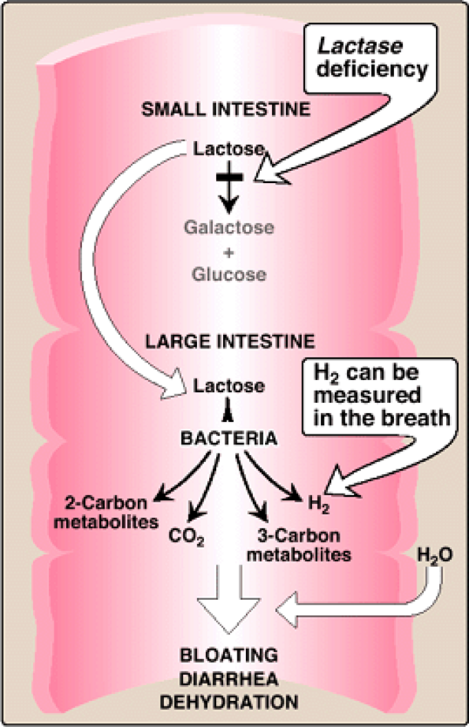

Slide 75
Diagnosis of lactose intolerance
Medical family and diet history including a review of symptoms
Physical examination
Medical tests

Slide 76
Medical tests
Hydrogen breath test
Stool acidity test

Slide 77
Sucrase deficiency
A rare condition showing the signs and symptoms of lactase deficiency. It occurs early in childhood

Slide 78
Monosaccharide malabsorption
This is a congenital condition in which glucose and galactose are absorbed slowly due to defect in the carrier mechanism
Because fructose is not absorbed by the carrier system its absorption is normal

Slide 79
Fate of absorbed sugars
Monosaccharides (glucose galactose and fructose) resulting from carbohydrate digestion are absorbed and undergo the following fate:

Slide 80
A. Uptake by tissues (liver):
After absorption the liver takes up sugars where galactose and fructose are converted into glucose

Slide 81
B. Glucose utilization by tissues:
Glucose may undergo one of the following fate:

Slide 82
Oxidation:
Through
Major pathways (glycolysis and Krebs' cycle) for production of energy
Hexose monophosphate pathway: for production of ribose, deoxyribose and NADPH ⁺ H⁺
Uronic acid pathway: for production of glucuronic acid, which is used in detoxification and enters in the formation of mucopolysaccharide

Slide 83
Storage:
in the form of:
Glycogen: glycogenesis
Fat: lipogenesis

Slide 84
Conversion:
To substances of biological importance:
Ribose & deoxyribose → RNA and DNA
Lactose → milk
Glucosamine & galactosamine → mucopolysaccharides
Glucoronic acid → mucopolysaccharides
Fructose → in semen

Slide 85


